Slide 1
MARKETING ANALYTICS
SESSION 13:
CUSTOMER LIFETIME VALUE
Professor Sonnier
Texas MSBA Program
Fall 2022

Slide 2
MARKETING MANAGEMENT
The Essence of Marketing
Customer
Acquisition
Customer
Retention
“The purpose of a business is to create and keep a customer. To do that you have to produce and deliver goods and services that people want and value at prices and under conditions that are reasonably attractive relative to those offered by others to a proportion of customers large enough to make those prices and conditions possible.”
-- Theodore Levitt, “Marketing and the Corporate Purpose” in The Marketing Imagination (New York: Free Press), 1986.

Slide 3
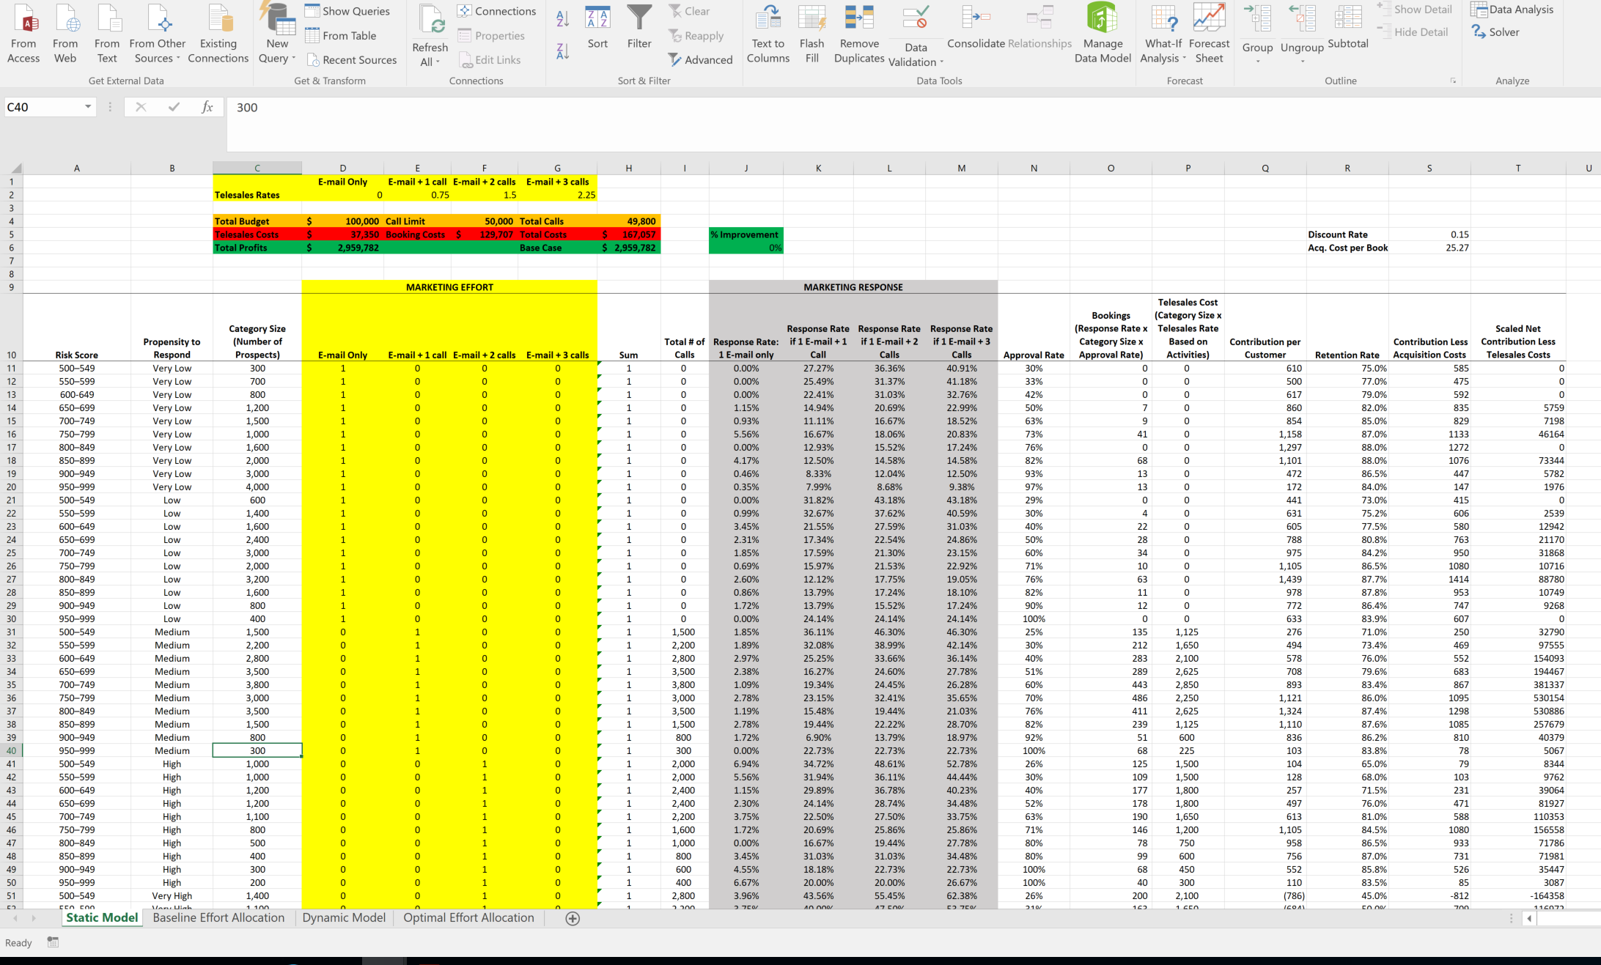
CUSTOMER LIFETIME VALUE
Acquisition vs. Development and Retention
Case Study of Resource Allocation for a Bank
Door-to-door sales model (for acquisition)
For cross sell, email and telesales calls are sufficient
How to optimize cross sell efforts?

Slide 4
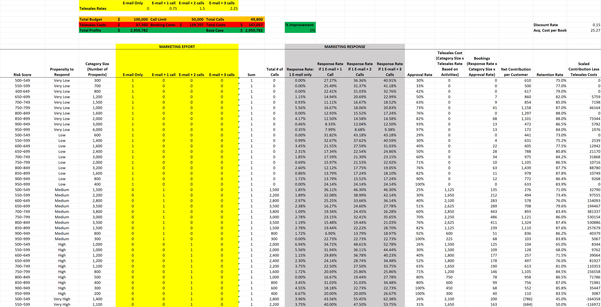
CUSTOMER LIFETIME VALUE
Segmentation of Existing Customer Base
For their existing customers the bank has a risk score
Based on past marketing efforts the company also has knowledge of customer propensity to respond to marketing efforts
Together these data form a basis for customer segmentation

Slide 5
CUSTOMER LIFETIME VALUE
Allocating Marketing Effort
Bank currently engages in different levels of marketing effort across the various segments
Response depends on effort level
Firm chooses level of contact
Email
Email + Telephone
1, 2, or 3 calls
Only one of these options allowed

Slide 6
CUSTOMER LIFETIME VALUE
Segments Seem to Make Sense

Slide 7
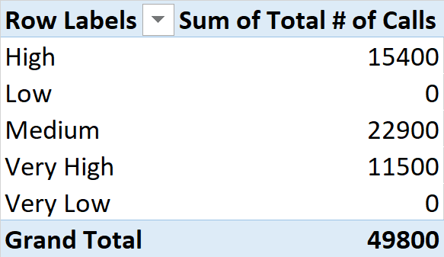
CUSTOMER LIFETIME VALUE
Allocating Marketing Effort
What is the relationship between the cumulative effort (i.e., the total # of calls) and the propensity to respond?

Slide 8
CUSTOMER LIFETIME VALUE
Allocating Marketing Effort
About 50,000 calls are allocated
Efforts are clearly focused on propensity to respond
Low and Very Low segments are receiving no calls

Slide 9
CUSTOMER LIFETIME VALUE
Allocating Marketing Effort
Bank seems to be allocating marketing effort towards customers with higher response probability
Consistent with what we learned in Targeting lecture
But consider the context---is there anything unique about marketing financial services in general?

Slide 10
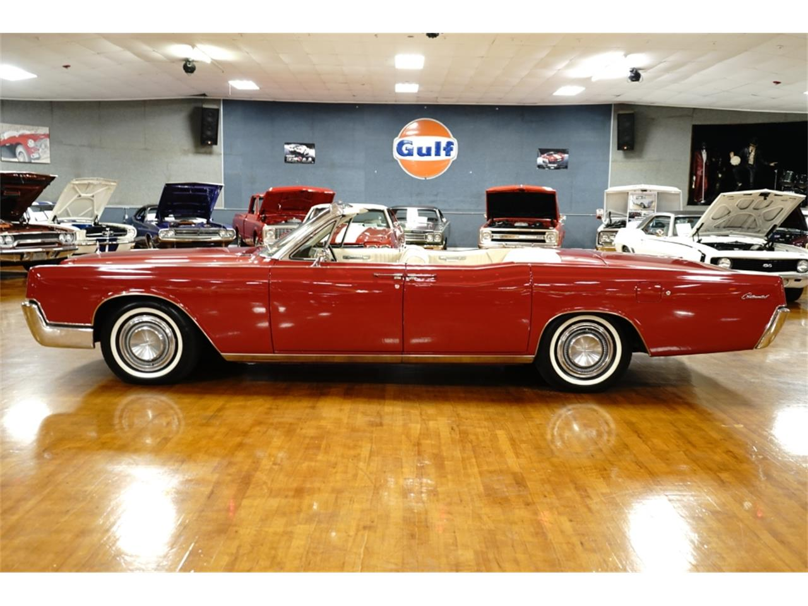
CUSTOMER LIFETIME VALUE
Consider the 1967 Lincoln Continental

Slide 11
CUSTOMER LIFETIME VALUE
Information Asymmetry in Credit and Lending Markets
Moral hazard
Once the transaction is complete (i.e., credit is extended or an insurance policy is written) the buyer engages in risky activities or behavior
Adverse selection
Prior to the transaction taking place, there is an information asymmetry between the buyer and seller.
High risk consumers are in need of credit, actively seek credit, and likely to respond if offered credit. Thus, buyers more likely to default are also more likely to be selected.

Slide 12
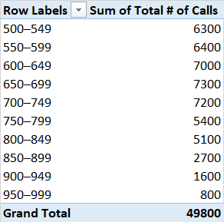
CUSTOMER LIFETIME VALUE
Allocating Marketing Effort
What is the relationship between the cumulative effort (i.e., the total # of calls) and risk score?

Slide 13
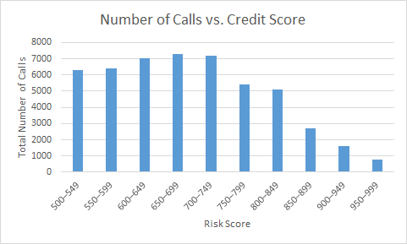
CUSTOMER LIFETIME VALUE
Allocating Marketing Effort
Targeting based on response only results in high risk customers being targeted
Profits are a function of both propensity to respond as well as credit risk!
What are total profits from marketing efforts?

Slide 14
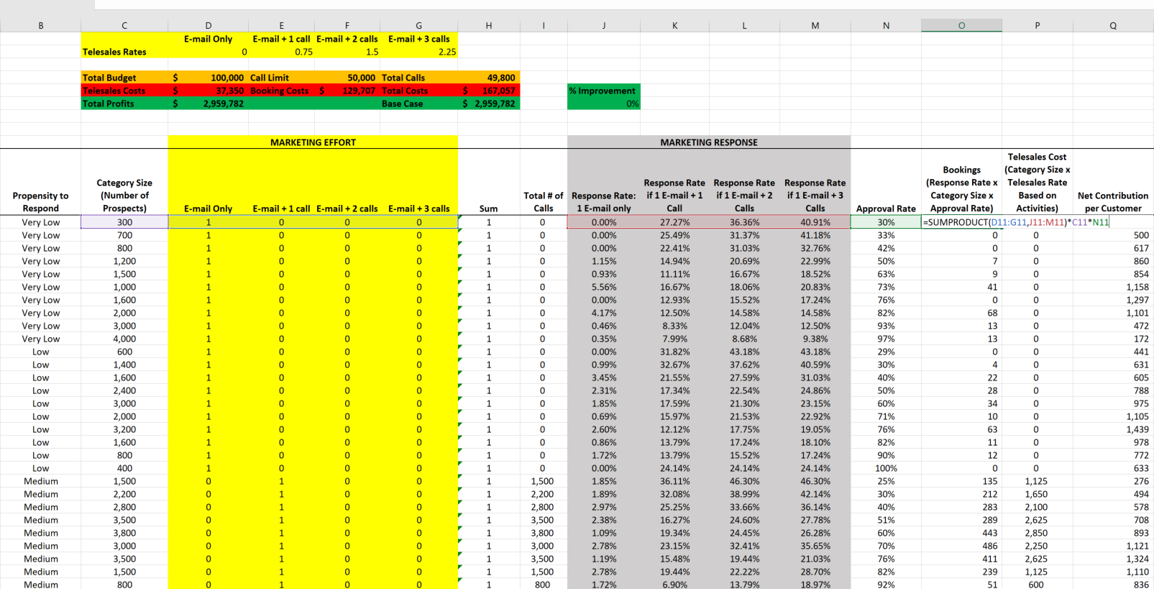
CUSTOMER LIFETIME VALUE
Computing Profits
Compute the Number of Bookings
Response Rate for Effort Level x Category Size x Approval Rate

Slide 15
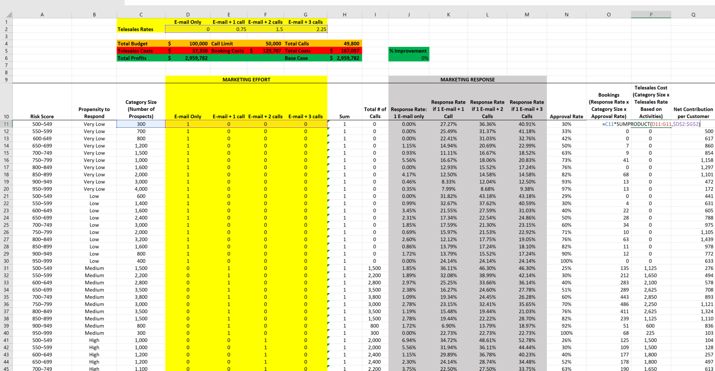
CUSTOMER LIFETIME VALUE
Computing Profits
Compute the Telesales Costs
Category Size x the Telesales Rates for the Effort Level

Slide 16
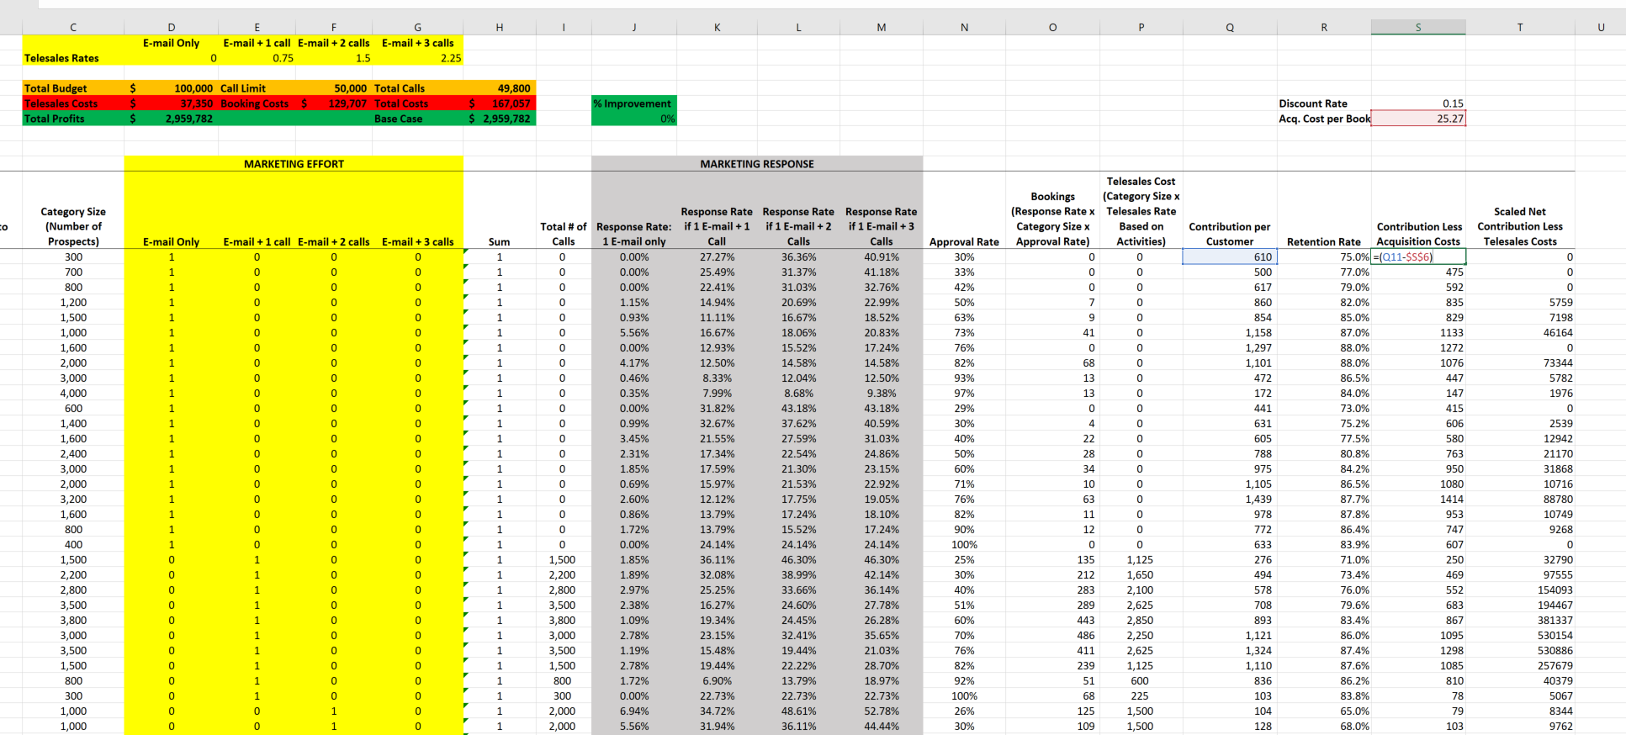
CUSTOMER LIFETIME VALUE
Computing Profits
Compute Contribution Less Acquisition Cost

Slide 17
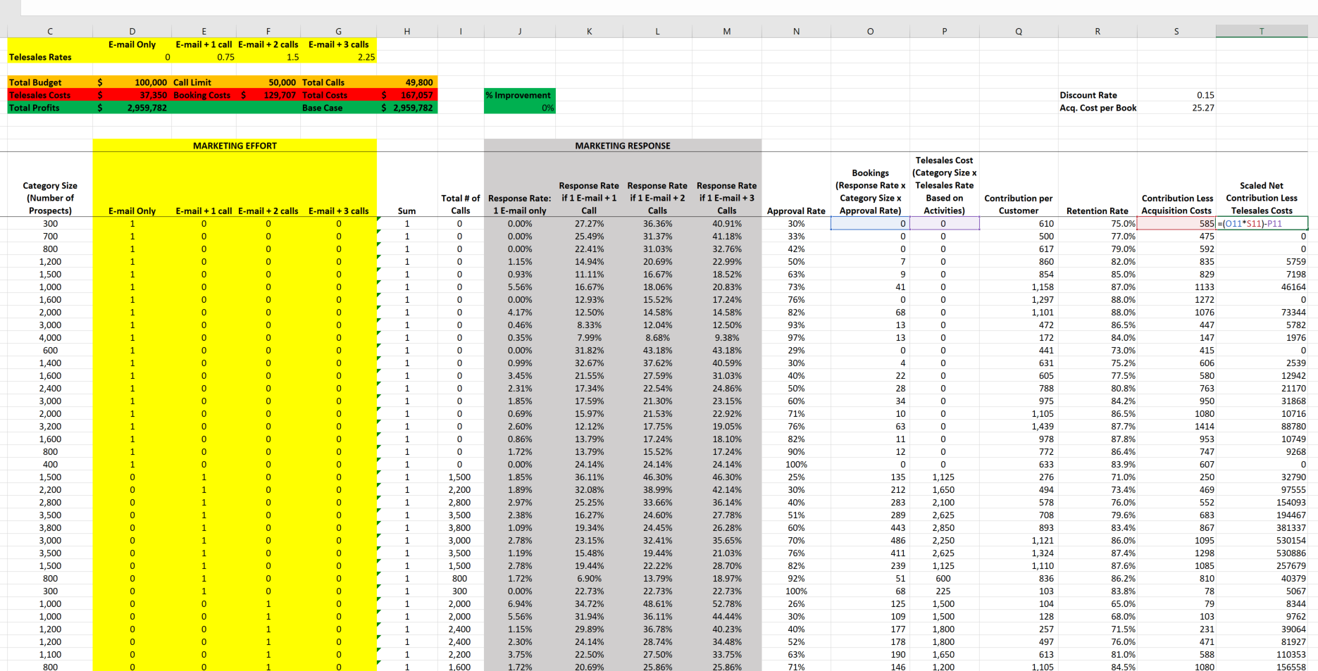
CUSTOMER LIFETIME VALUE
Computing Profits
Scale Net Contribution by the Number of Bookings and Deduct Telesales Costs

Slide 18
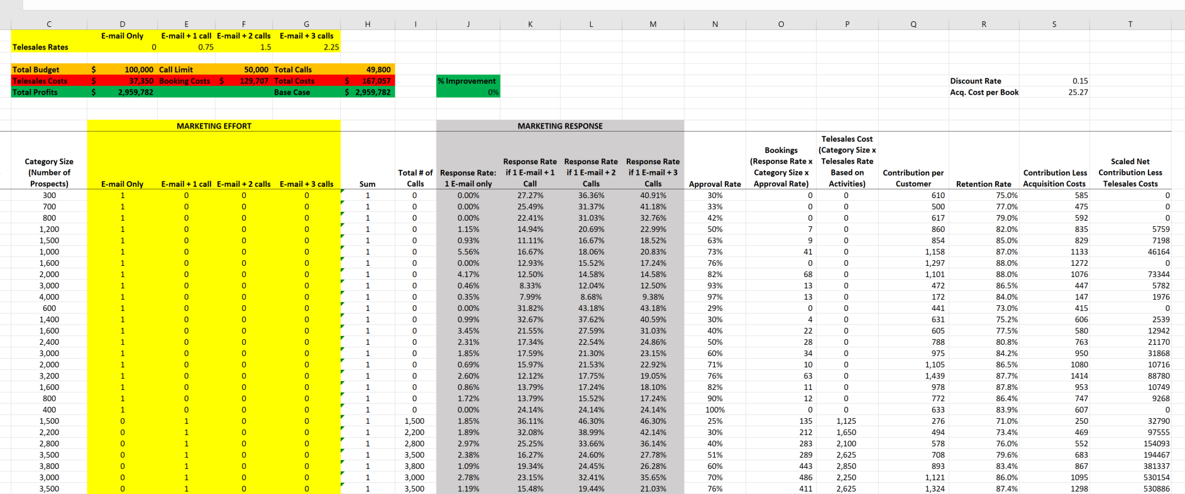
CUSTOMER LIFETIME VALUE
Computing Profits
Total profits are sum of Scaled Net Contribution Less Telesales costs (Column T)
At the baseline, total costs are ~$168,000
At this baseline total profits are ~$3MM

Slide 19
CUSTOMER LIFETIME VALUE
Optimizing Marketing Efforts
These customers may remain with me into the future generating revenues and profits
My analysis has not accounted for this
Consider an annual contribution of $150
Year 0 | Year 1 | Year 2 | Year 3
--- | $150 | $150 | $150
Static view treats contribution as a one time event
It may be too optimistic to treat contribution as $150 x T where T is some planning horizon (i.e., a 3 year horizon would yield $150 x 3=$450)
I would like to for a more dynamic view but I need to account for…
The time value of money
The probability that the customer remains active into future periods

Slide 20
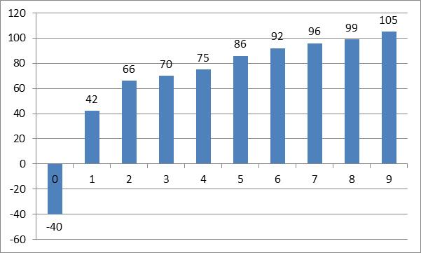
CUSTOMER LIFETIME VALUE
Profit Patterns for Credit Card Company
Year | Profit per Customer
0
1 | $42
2 | $66
3 | $70
4 | $75
5 | $86
6 | $92
7 | $96
8 | $99
9 | $105
Totals
Average Profit per Customer ($) in Cohort
Age of Customer Account (years)
Assume a 10% discount rate
What about a constant cash flow into perpetuity (i.e. an infinite planning horizon)?
Source: Reichheld and Teal, The Loyalty Effect (1997)

Slide 21
A CASH FLOW OVER AN INFINITE HORIZON
What is the Present Value?
Where d is the discount rate.
Does this suggest a way to estimate the lifetime value of a customer?
What, if any, assumptions are being made?

Slide 22
A SIMPLE VIEW OF LIFETIME VALUE
The Present Value of a Margin Received into Perpetuity
Average Profit per Customer ($) in Cohort
Constant $42 Over Infinite Horizon
Cash Flows Over Nine Years
Age of Customer Account (years)
What if we assumed the Year 1 Average Profit of $42 as the perpetuity and a 10% discount rate?
Compared to PV of actual cash flows in graph?
But what about the probability that the customer leaves?

Slide 23
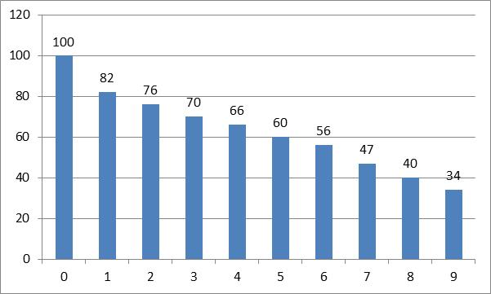
CUSTOMER LIFETIME VALUE
Retention Impacts Customer Lifetime
Year | Profit per Customer | Annual Retention Probability
0 |  | 100%
1 | $42 | 82%
2 | $66 | 93%
3 | $70 | 92%
4 | $75 | 94%
5 | $86 | 91%
6 | $92 | 93%
7 | $96 | 84%
8 | $99 | 85%
9 | $105 | 85%
Totals
Probability a Customer Remains by Age
Age of Customer Account (years)
If r is constant
Source: Reichheld and Teal, The Loyalty Effect (1997)

Slide 24
CUSTOMER LIFETIME VALUE
Putting the Pieces Together: Finite Horizon
Average Profit per Customer ($) in Cohort
Retention Probability
Age of Customer Account (years)
Age of Customer Account (years)
Just the discounted cash flows adjusted by the retention probabilities

Slide 25
CUSTOMER LIFETIME VALUE
Finite Horizon, Constant Margin, Constant Retention*
Average Profit per Customer ($) in Cohort
Retention Probability
Age of Customer Account (years)
Age of Customer Account (years)
*Assuming Margin and Retention Probability are Constant at Year 1 Levels

Slide 26
CUSTOMER LIFETIME VALUE
Putting the Pieces Together: Infinite Horizon
Average Profit per Customer ($) in Cohort
Retention Probability
Age of Customer Account (years)
Age of Customer Account (years)
Simplified Formula:
Assuming Year 1 Margin and Retention into Perpetuity

Slide 27
CUSTOMER LIFETIME VALUE
What is the impact of assuming an infinite planning horizon?

Slide 28
CUSTOMER LIFETIME VALUE
Putting the Pieces Together: Infinite Horizon
Assumptions:
Constant Margin of $42 received from Year 1 into perpetuity
Constant Retention Rate of 82%
Discount Rate of 10%
What if we received a $42 margin from period 0 into perpetuity?

Slide 29
CUSTOMER LIFETIME VALUE
What About Acquisition Costs (AC)?
Average Profit per Customer ($) in Cohort
Retention Probability
Age of Customer Account (years)
Age of Customer Account (years)

Slide 30
WHAT IS THE VALUE OF A CUSTOMER?
Two Vantage Points
The finite time version
The infinite time version (assuming constant margin and retention rate!)
Net CLV is just CLV minus Acquisition Costs (AC)

Slide 31
CUSTOMER LIFETIME VALUE: EXAMPLE 1
FEDEX COURIER PAK
140 accounts in advertising industry use 2,285 Courier Paks (CP) per month
CP price is $12.50 and variable cost is $4.25
Retention rate=0.9, discount rate=12% per year
What is the maximum FedEx should be willing to spend to acquire a new account in this industry?
Annual sales per account: (2,285 x 12) / 140 = 195.86
Annual margin per account: 195.86 x $8.25 = $1,615.82

Slide 32
CUSTOMER LIFETIME VALUE: EXAMPLE 1
FEDEX COURIER PAK

Slide 33
CUSTOMER LIFETIME VALUE
Putting the Pieces Together
Customer Lifetime Value (CLV)
CLV is the present value of all future streams of profits a customer generates over his expected life with the firm
Why is this Useful?
Guidance to managers on acquisition spending
Guidance to managers on resource allocation
Estimate of firm value
Could be a basis for segmentation

Slide 34
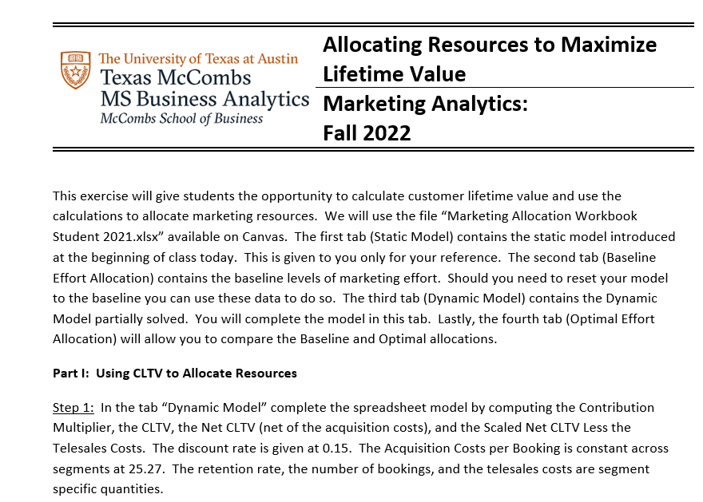
Computing Dynamic Profits

Slide 35
CUSTOMER LIFETIME VALUE
Computing Profits
Let’s consider a more dynamic view of profits with CLTV calculation

Slide 36
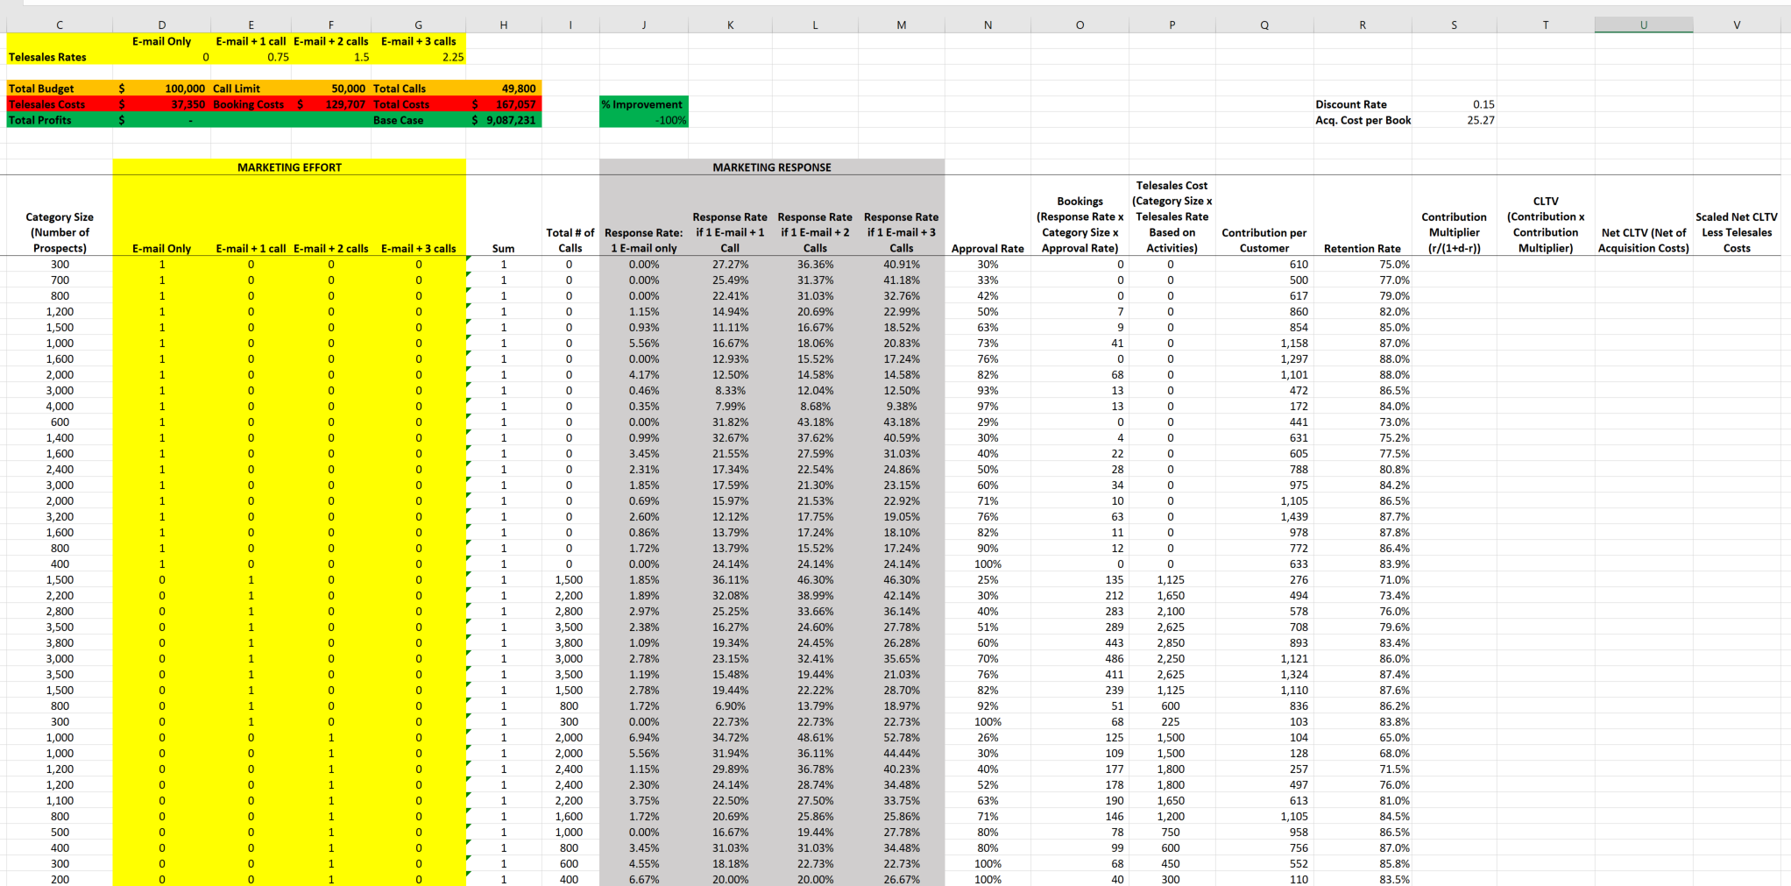
CUSTOMER LIFETIME VALUE
Computing Dynamic Profits
We have the margin (i.e. the contribution per customer)
Compute the multiplier for each segment
Compute CLTV
Compute Net CLTV
Scale Net CLTV (by number of bookings) and Deduct Telesales Costs

Slide 37

CUSTOMER LIFETIME VALUE
Computing Dynamic Profits
We have the margin (i.e. the contribution per customer)
Compute the multiplier for each segment

Slide 38
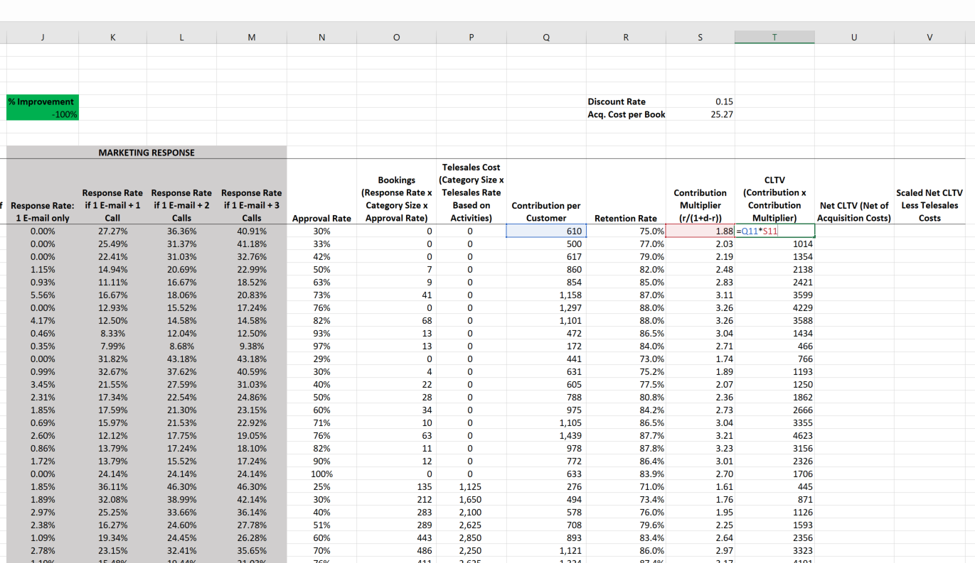
CUSTOMER LIFETIME VALUE
Computing Dynamic Profits
We have the margin (i.e. the contribution per customer)
Compute the multiplier for each segment
Compute the CLTV

Slide 39
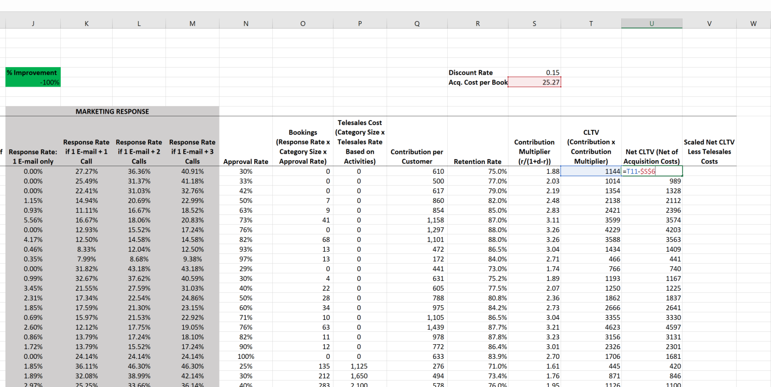
CUSTOMER LIFETIME VALUE
Computing Dynamic Profits
We have the margin (i.e. the contribution per customer)
Compute the multiplier for each segment
Compute the CLTV
Compute the Net CLTV

Slide 40

CUSTOMER LIFETIME VALUE
Computing Dynamic Profits
We have the margin (i.e. the contribution per customer)
Compute the multiplier for each segment
Compute the CLTV
Compute the Net CLTV
Compute the Scaled Net CLTV Less Telesales Costs

Slide 41
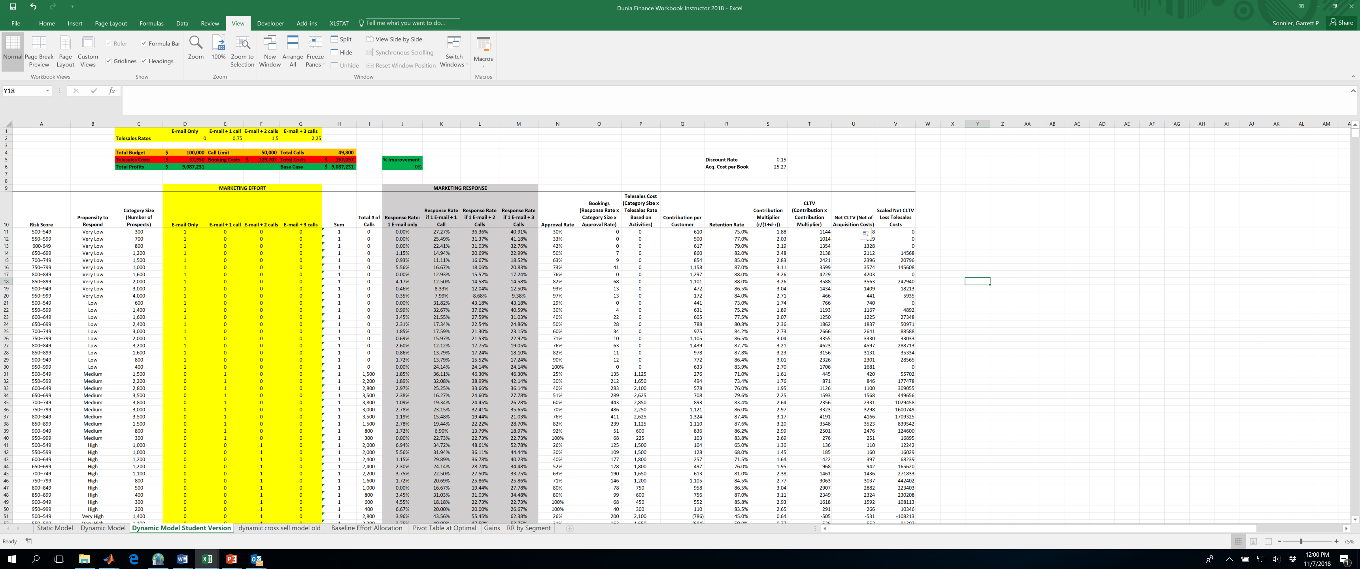
CUSTOMER LIFETIME VALUE
Computing Dynamic Profits
Total profits are the sum of the scaled net CLTV less telesales costs (Column V)
Total profits are just over $9 million
I want to apply a budget constrain of $100,000 and a call constraint of 50,000 calls
How should I re-allocate my effort?

Slide 42
CUSTOMER LIFETIME VALUE
Optimizing Marketing Effort
Find the contact pattern that maximizes total dynamic profits
Subject to a budget constraint of $100,000 and call constraint of 50,000 calls
Also need to account for the fact that I cannot do a fraction of an activity (each activity can be only 0 or 1).
Also need to account for the fact that I only can do one of the four activities (email, email+1 call, email+2 calls, email+3 calls).

Slide 43
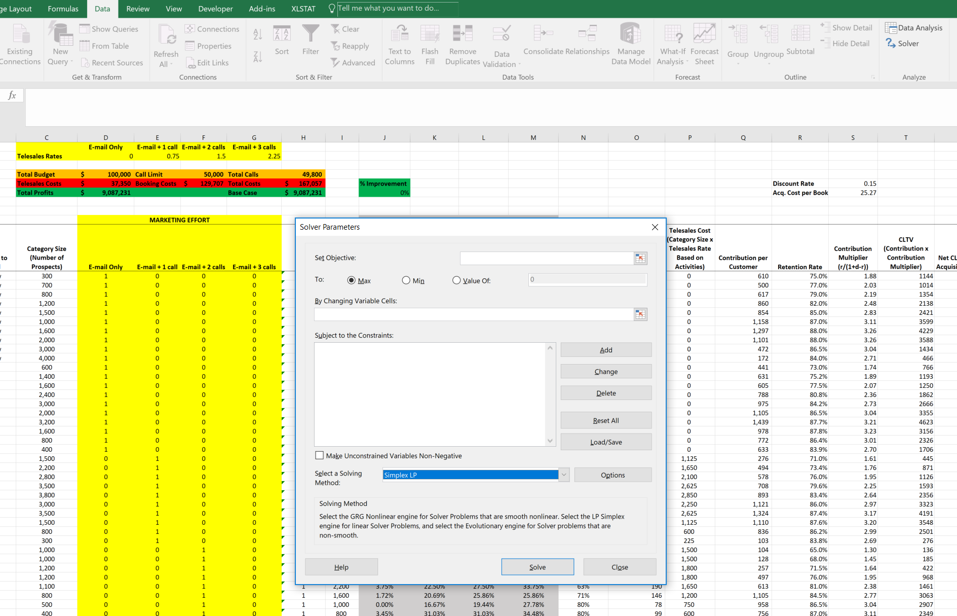
CUSTOMER LIFETIME VALUE
Optimizing Marketing Effort
Click on Data tab
Click on Solver

Slide 44
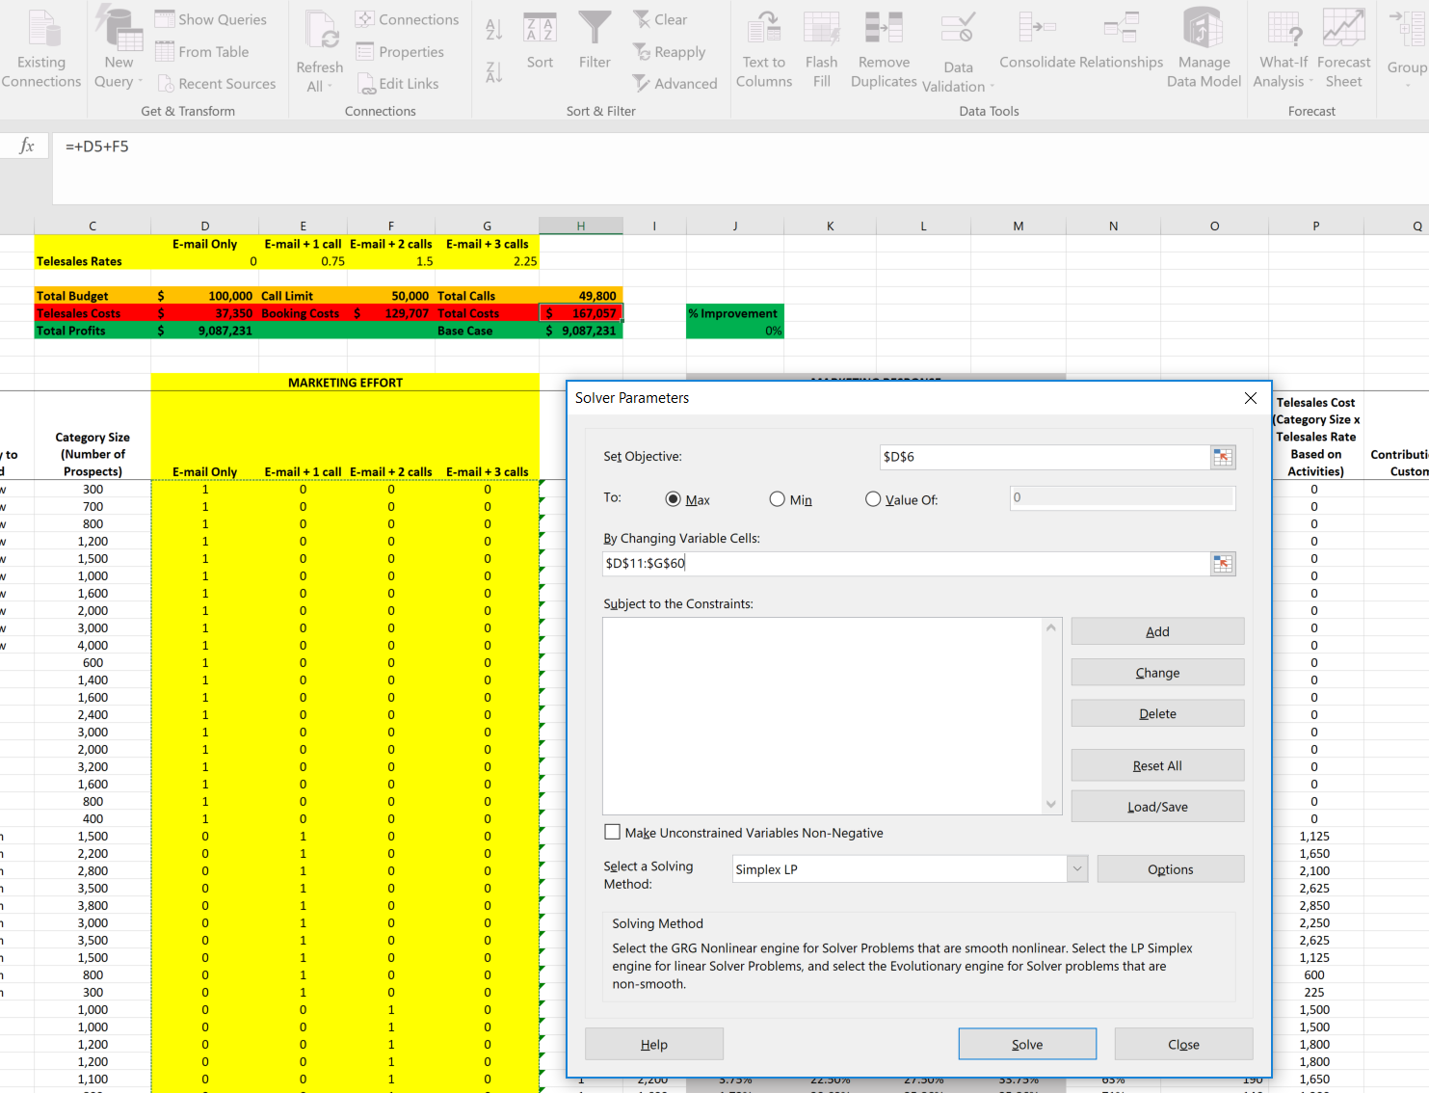
CUSTOMER LIFETIME VALUE
Optimizing Marketing Effort
Set Objective to maximize Total Profits (In Cell D6)
By changing the Marketing Effort variables (In Cells D11:G60)
Now add constraints

Slide 45
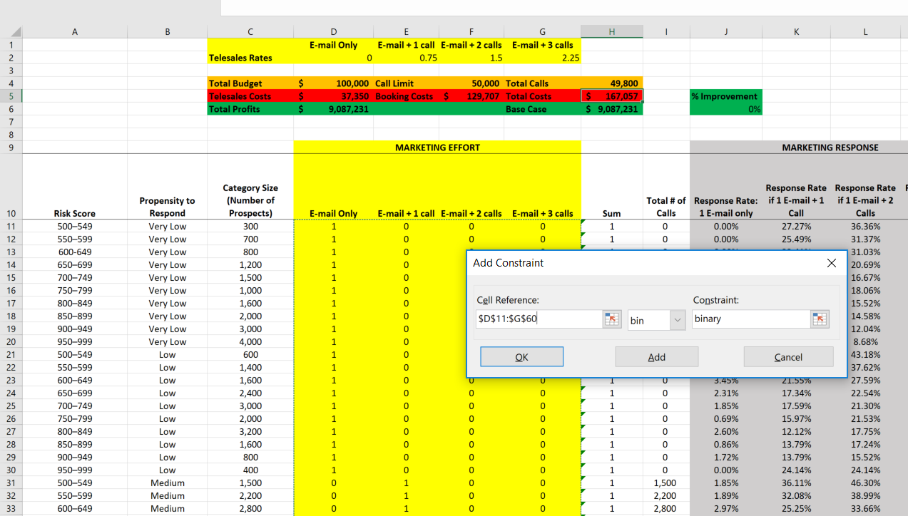
CUSTOMER LIFETIME VALUE
Optimizing Marketing Effort
Account for the fact that I cannot do a fraction of an activity (each activity can be only 0 or 1).
Apply binary constraint

Slide 46
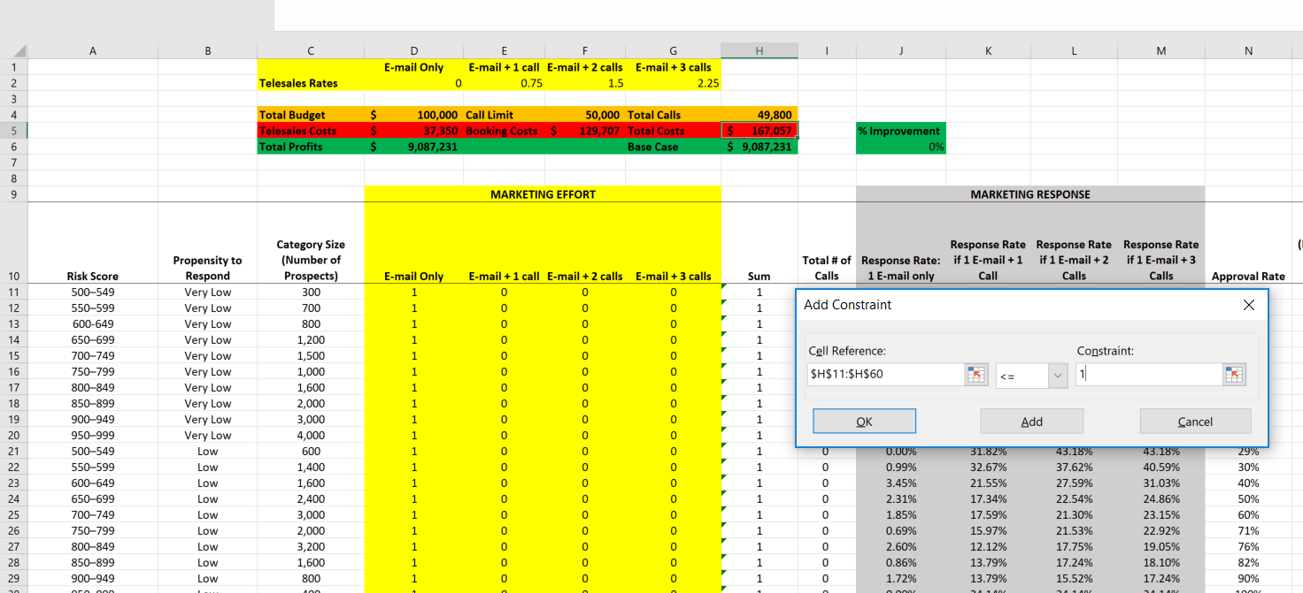
CUSTOMER LIFETIME VALUE
Optimizing Marketing Effort
Account for the fact that I can do, at most, 1 activity
Apply less than or equal to constraint

Slide 47
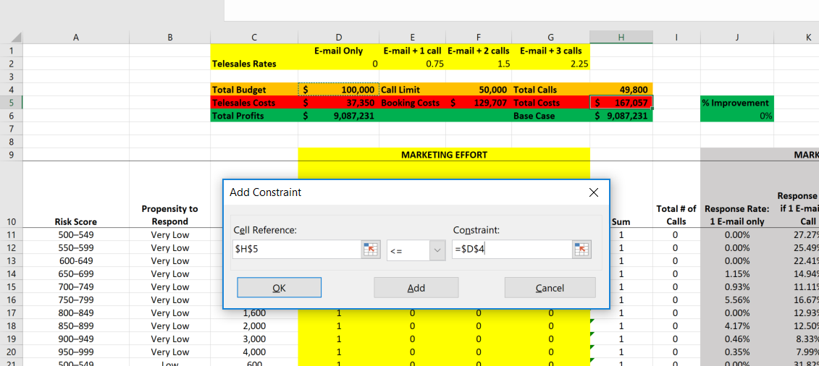
CUSTOMER LIFETIME VALUE
Optimizing Marketing Effort
Set costs to be less than or equal to total budget of $100K
Apply less than or equal to constraint

Slide 48

CUSTOMER LIFETIME VALUE
Optimizing Marketing Effort
Set total calls to be less than or equal to 50K
Apply less than or equal to constraint

Slide 49
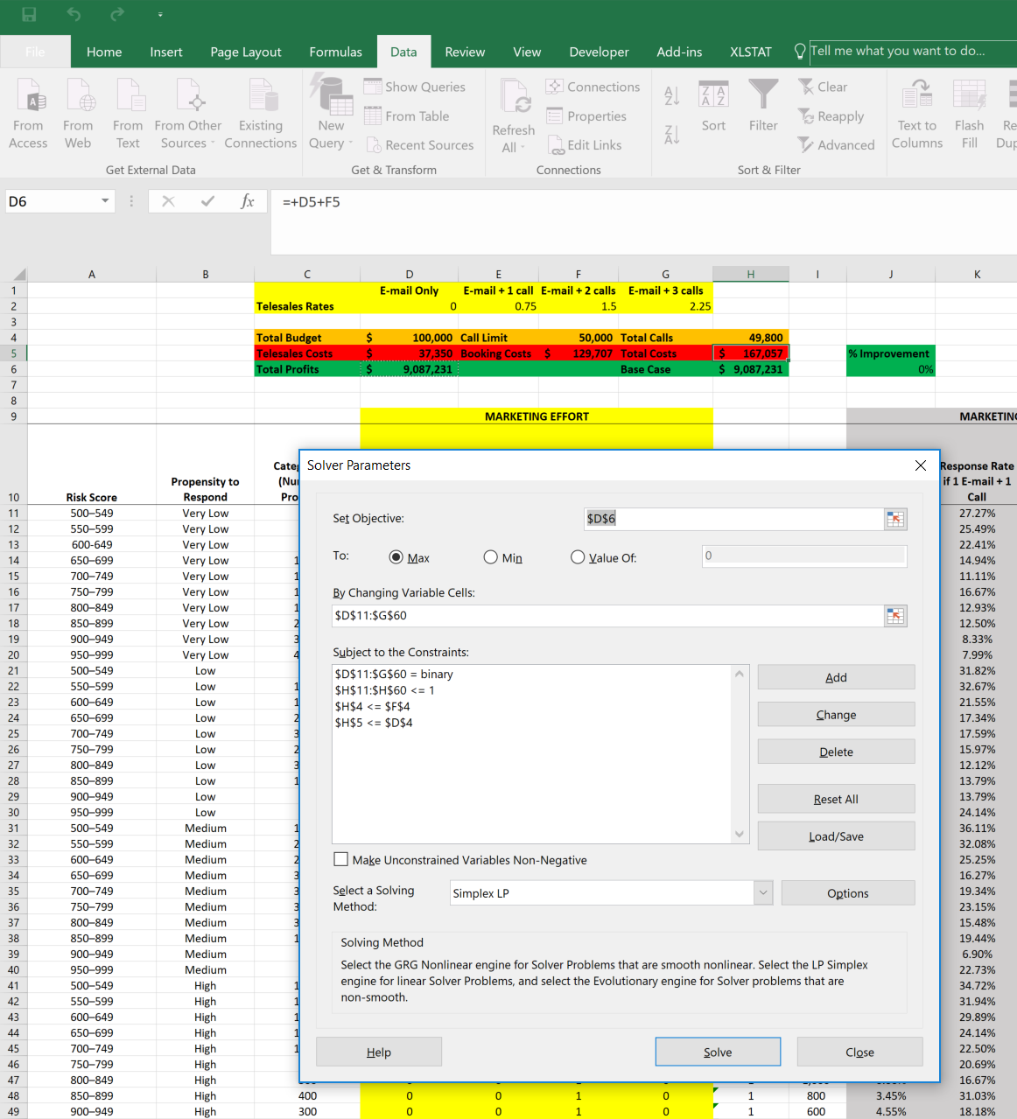
CUSTOMER LIFETIME VALUE
Optimizing Marketing Effort

Slide 50
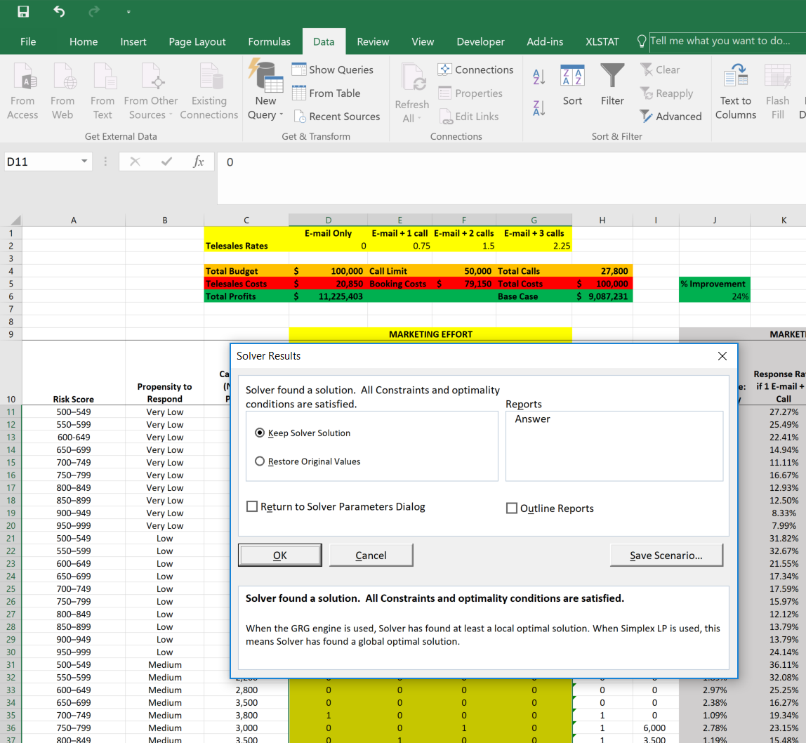
CUSTOMER LIFETIME VALUE
Optimizing Marketing Effort

Slide 51
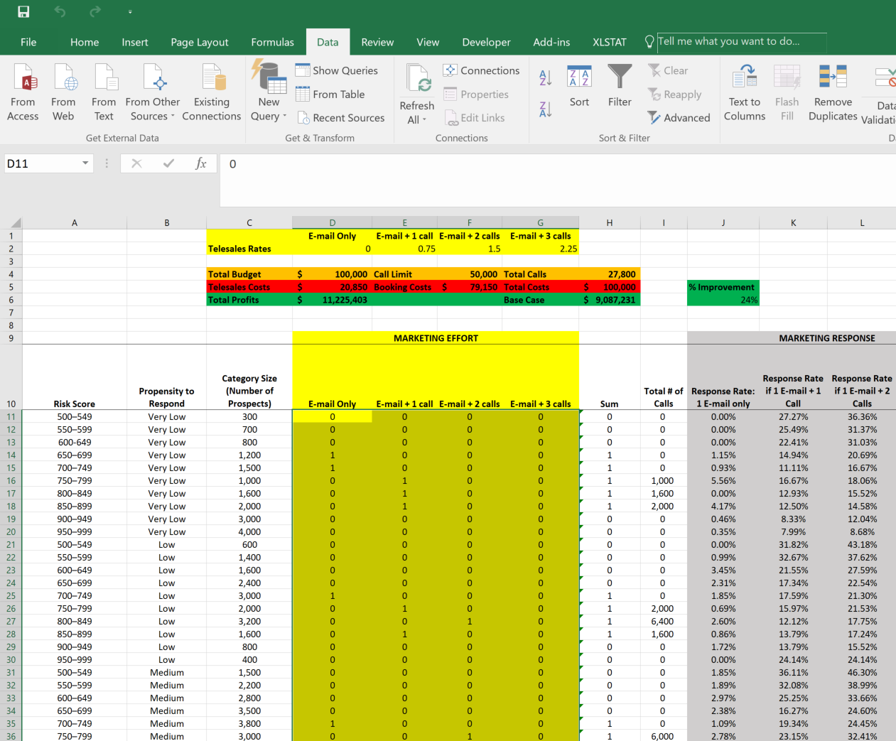
CUSTOMER LIFETIME VALUE
Optimizing Marketing Effort
By re-allocating resources we can achieve a 24% improvement in profits even after cutting costs down to $100,000
This analysis accounts for the future profitability of customers adjusted for retention probability and the time value of money

Slide 52
CUSTOMER LIFETIME VALUE
Baseline Marketing Effort
About 50,000 calls are allocated
Efforts are clearly focused on propensity to respond
Low and Very Low segments are receiving no calls

Slide 53
CUSTOMER LIFETIME VALUE
Calls vs Response Propensity at Optimal Solution
At baseline no calls were made to low or very low response customers
Accounting for profitability we see fewer calls overall and a higher fraction of calls allocated to these groups

Slide 54
CUSTOMER LIFETIME VALUE
Baseline Marketing Effort
High risk customers are being targeted

Slide 55
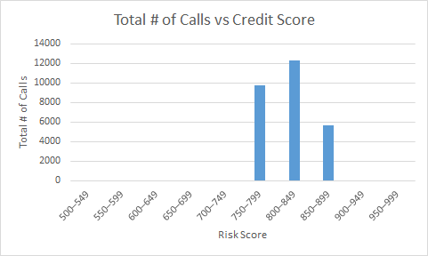
CUSTOMER LIFETIME VALUE
Calls vs Credit Score at Optimal Solution
At baseline customers across the risk spectrum were targeted
Accounting for profitability we see efforts more concentrated among higher credit score (lower risk) customers

Slide 56
CUSTOMER LIFETIME VALUE
Gains by Risk-Response Profile

Slide 57
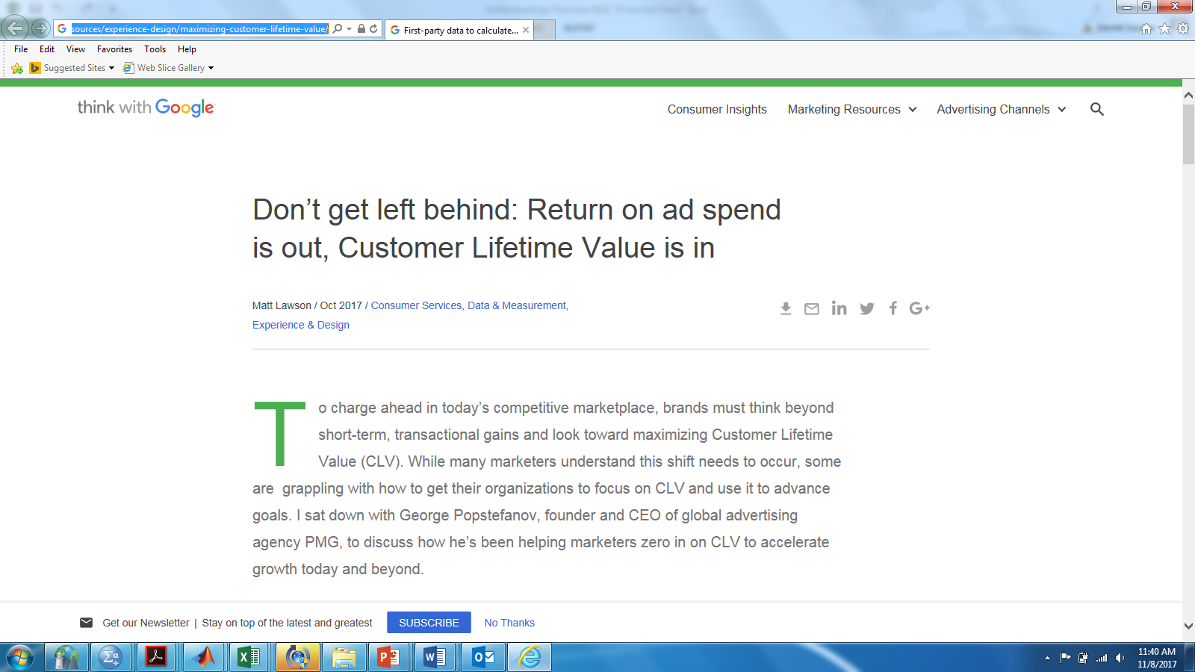
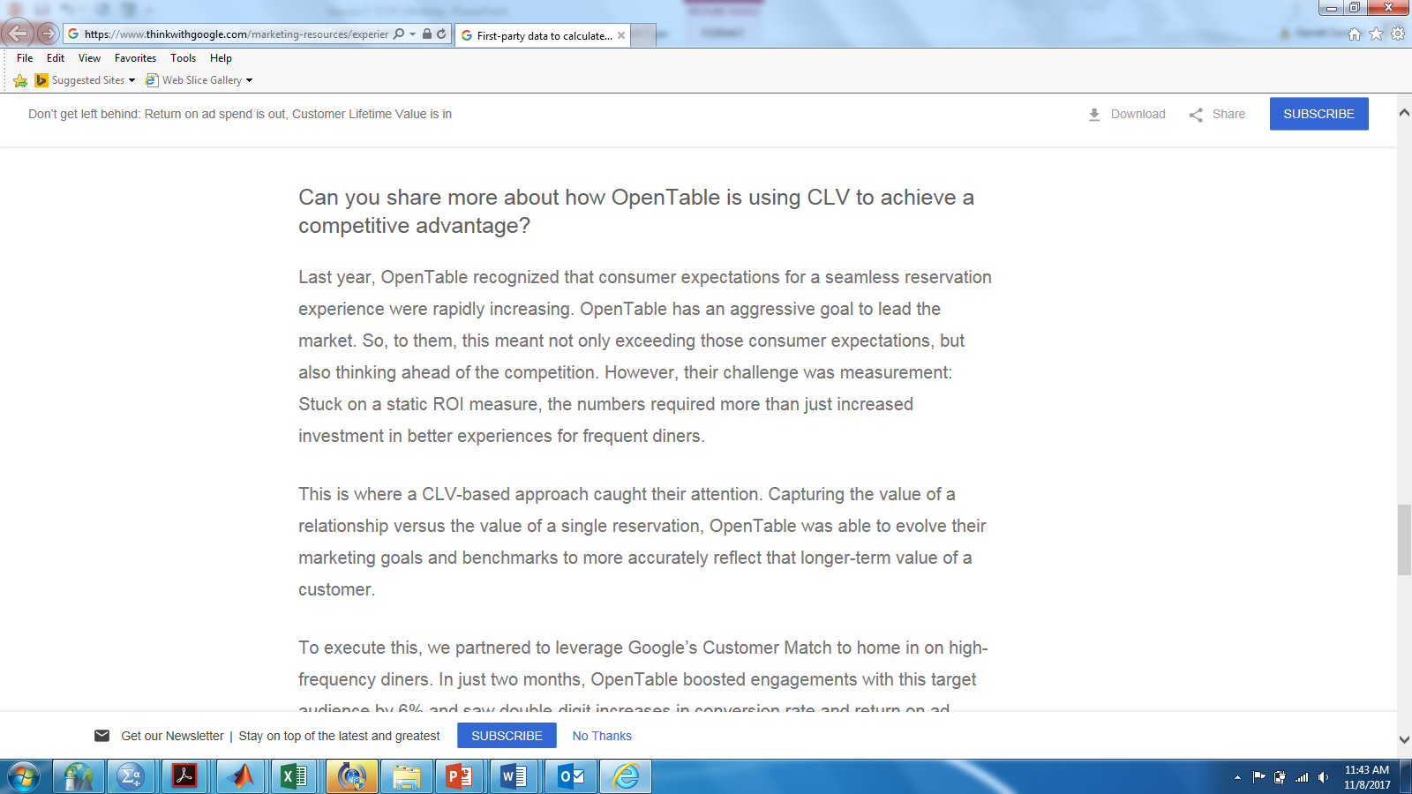
https://www.thinkwithgoogle.com/marketing-resources/experience-design/maximizing-customer-lifetime-value/

Slide 58
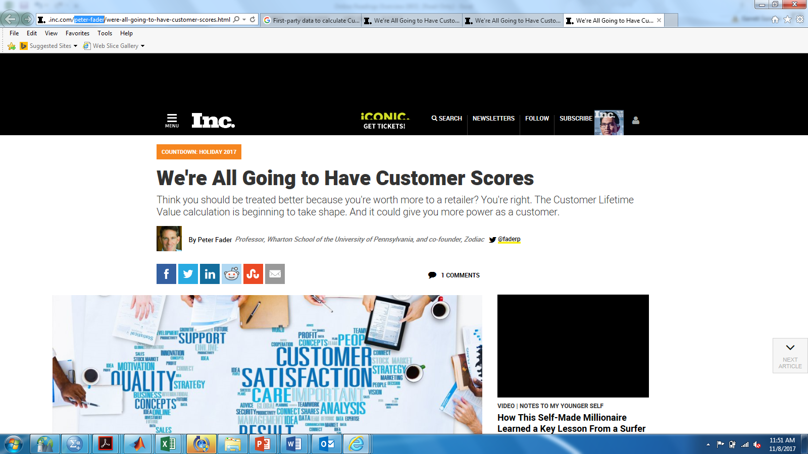
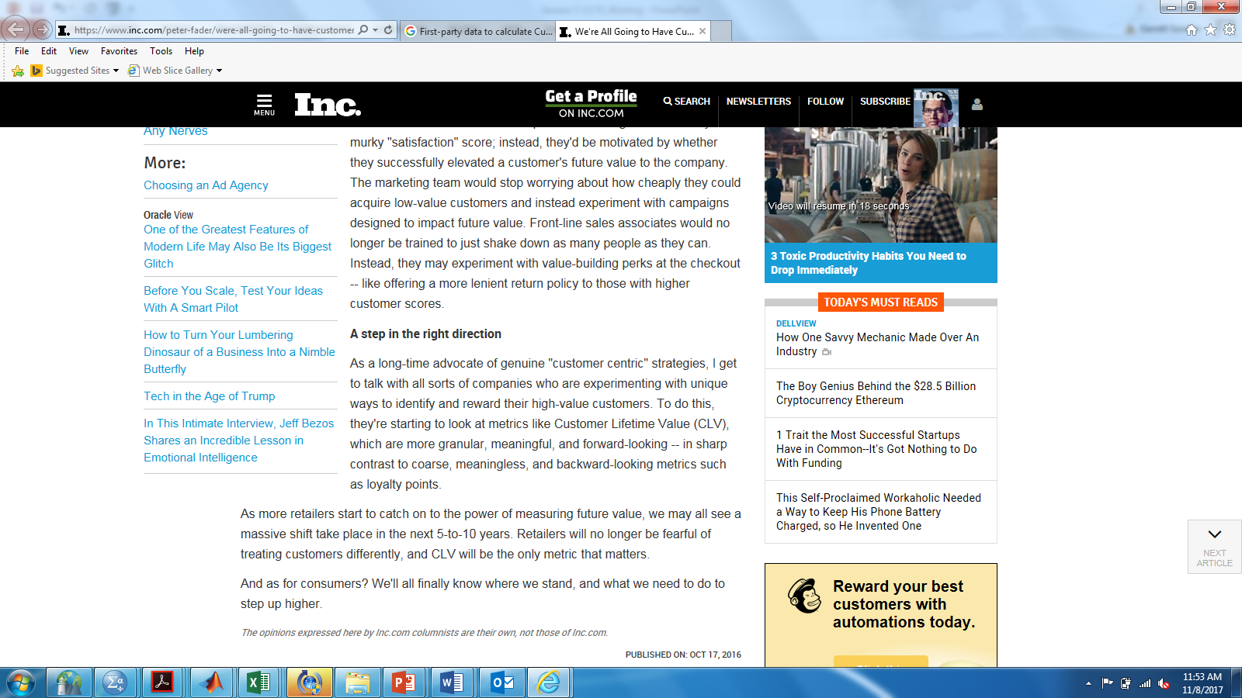

Slide 59
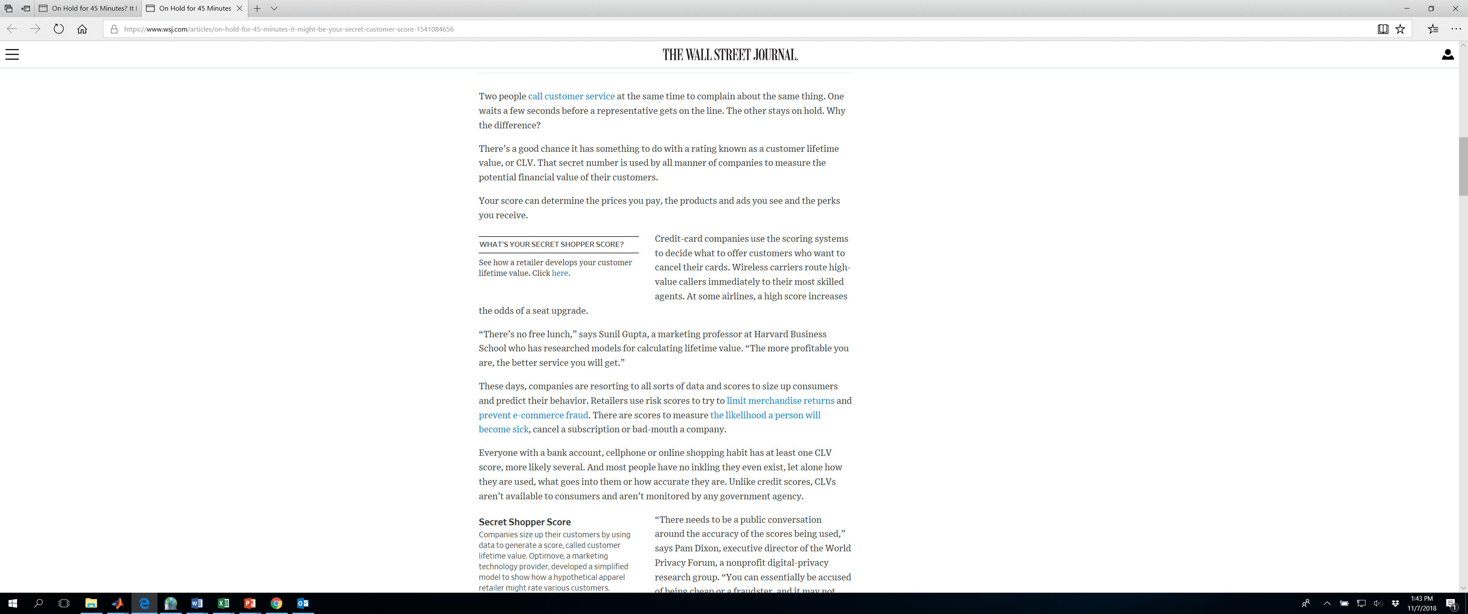
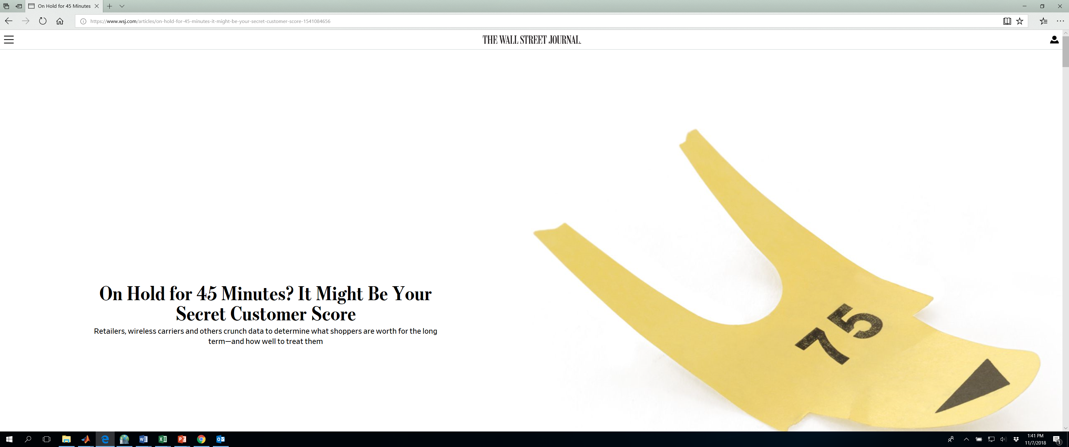

Slide 60
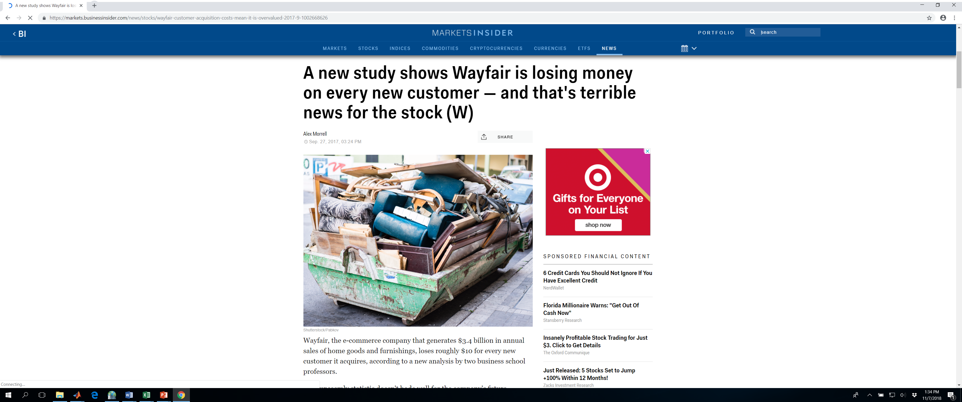
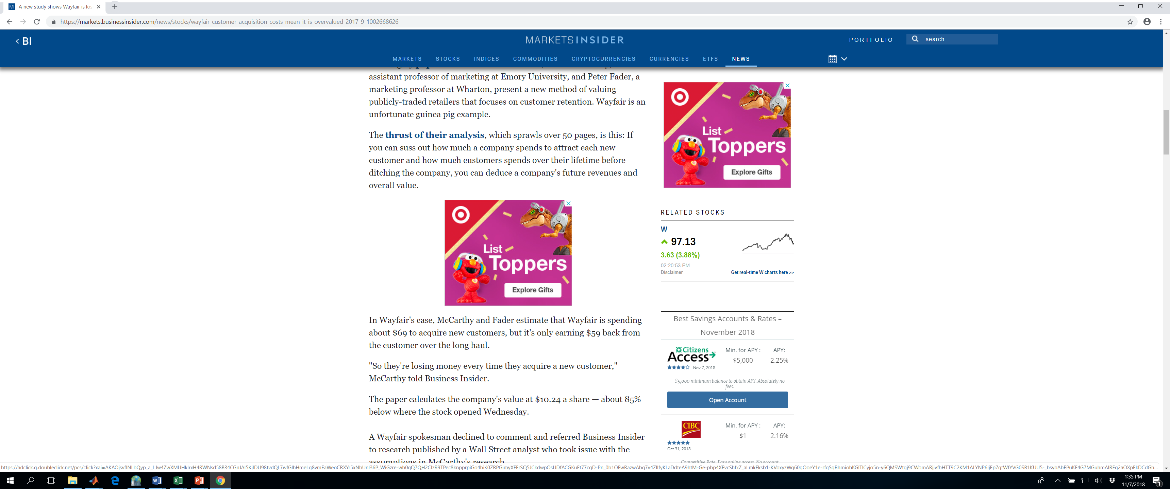

Slide 61
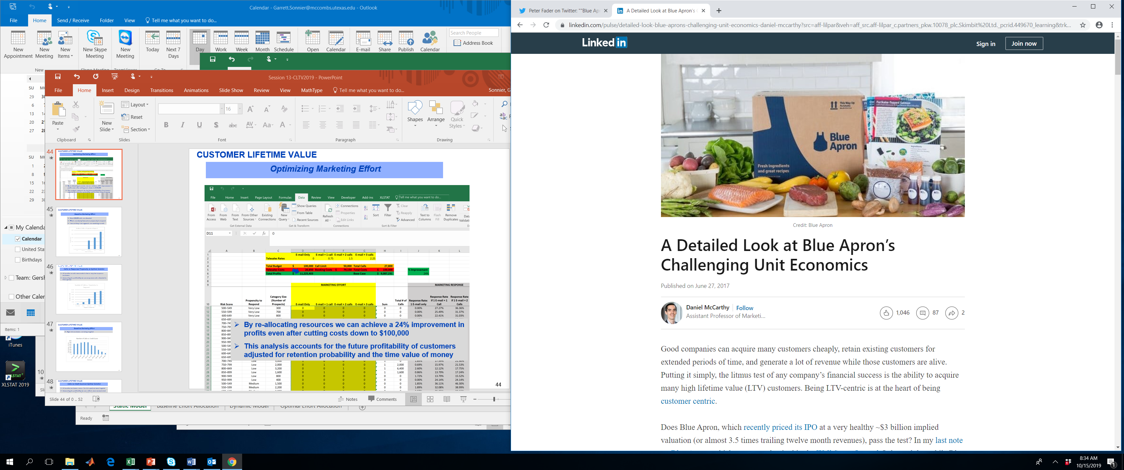
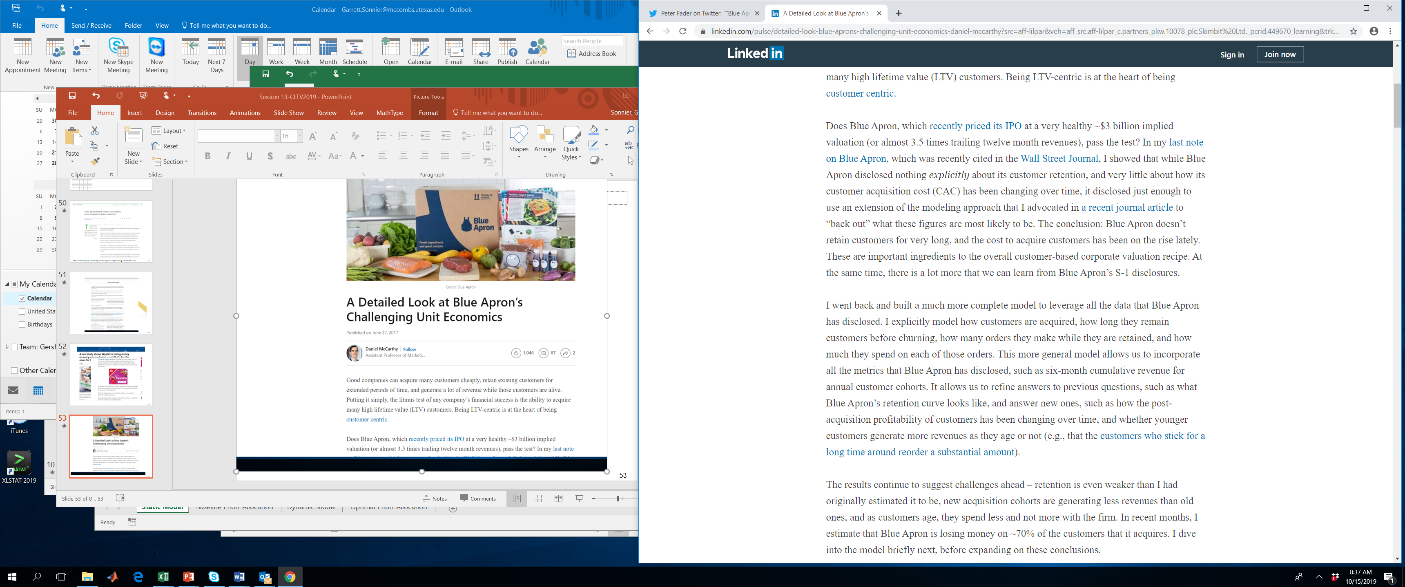

Slide 62
APPLICATIONS OF CUSTOMER LIFETIME VALUE
Key Concepts from Today
CLTV is a principled means of accounting for future profitability
Time value of money
Probability of retention
CLTV can be used
To allocate acquisition and retention spend
To value firms
To segment customers

